Slide 1
GEOCENTRICITY – The Truth ABOUT Our Universe

Slide 2
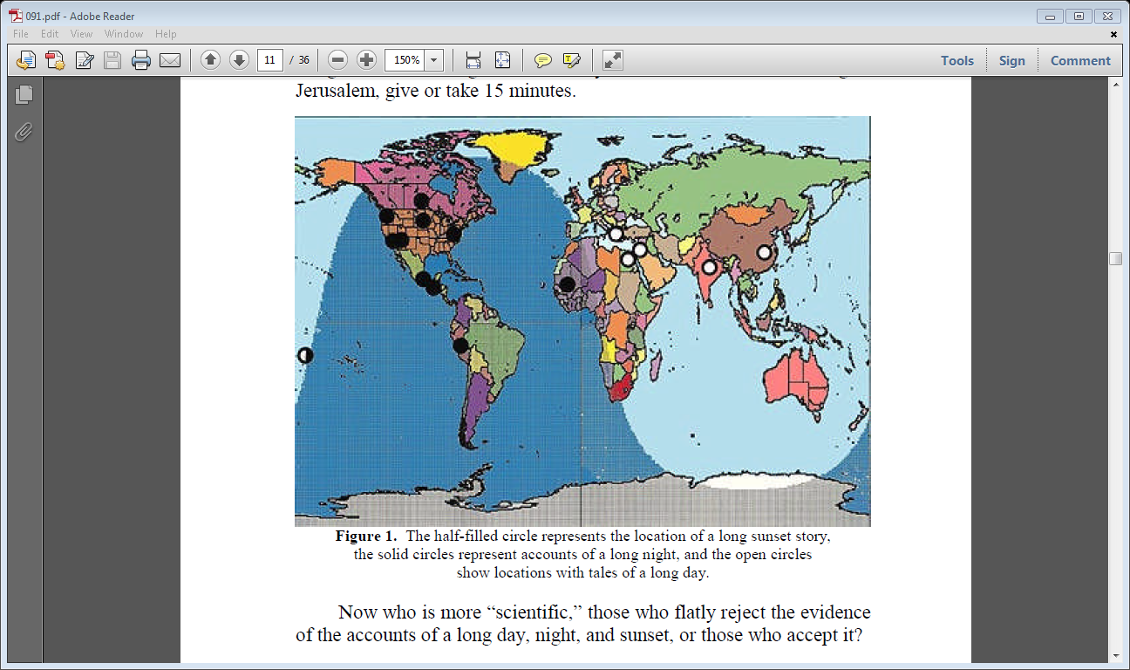
Joshua’s Long Day Stories Chart

Slide 3
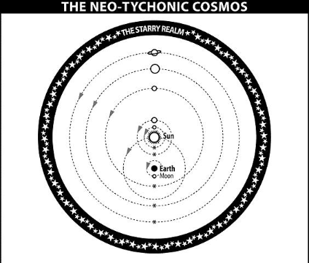
THE modified tychonian model

Slide 4
Copernican vs. Tychonic Model Start at 0:15 to 0:54 – https://www.youtube.com/watch?v=I73hycfdViA&index=18&list=FLXxypHWQkntQaZ15RZbuuuw
Notes:
Start at 0:15 to 0:54 - https://www.youtube.com/watch?v=I73hycfdViA&index=18&list=FLXxypHWQkntQaZ15RZbuuuw

Slide 5
HELIOCENTRIC VS. GEOCENTRIC DAILY AND YEARLY CYCLES
Start at 5:40 to 6:44 for Daily and Yearly Comparison Charts - https://www.youtube.com/watch?v=I73hycfdViA&index=18&list=FLXxypHWQkntQaZ15RZbuuuw
Notes:
Start at 5:40 to 6:44 for Daily and Yearly Comparison Charts - https://www.youtube.com/watch?v=I73hycfdViA&index=18&list=FLXxypHWQkntQaZ15RZbuuuw

Slide 6
≈ ±23° movement of Sun in the Yearly Cycle (causes seasons) End at 4:30 - https://www.youtube.com/watch?v=IcN5h8zEacM&list=FLXxypHWQkntQaZ15RZbuuuw&index=23
Notes:
End at 4:30 - https://www.youtube.com/watch?v=IcN5h8zEacM&list=FLXxypHWQkntQaZ15RZbuuuw&index=23

Slide 7
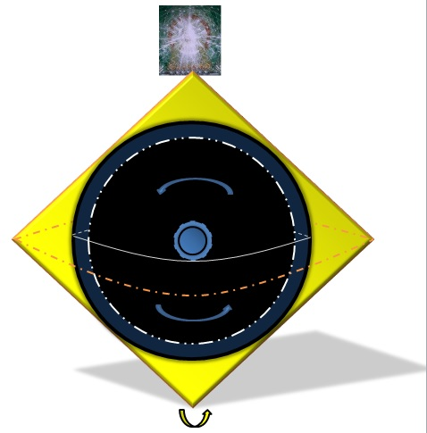
Biblical Model of the universe

Slide 8
Gyroscope = a TYPE OF How the Universe Rotates? Start at 1:22 and end at 2:00 - https://www.youtube.com/watch?v=cquvA_IpEsA&list=WL&index=5
Notes:
Start at 1:22 and end at 2:00 - https://www.youtube.com/watch?v=cquvA_IpEsA&list=WL&index=5

Slide 9
How God may cause the Universe to Wobble at ≈ ± 23° Start at 2:12 and end at 5:15 - https://www.youtube.com/watch?v=ekzwbt3hu2k&list=WL&index=11
Notes:
Start at 2:12 and end at 5:15 - https://www.youtube.com/watch?v=ekzwbt3hu2k&list=WL&index=11

Slide 10
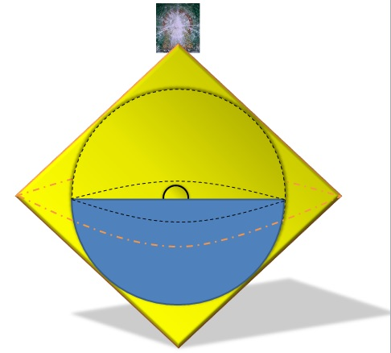
INITIAL CREATION

Slide 11
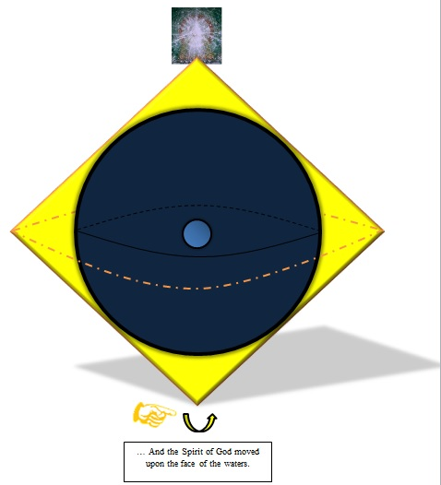
LUCIFER’S REBELLION AND RESULTS

Slide 12
Regeneration and renovation

Slide 13
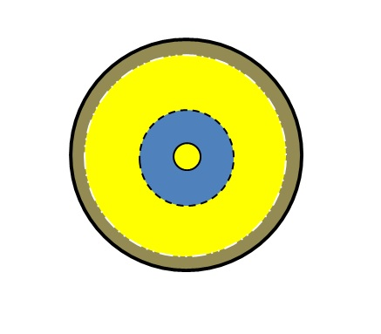
Paradise before lucifer’s fall??!

Slide 14
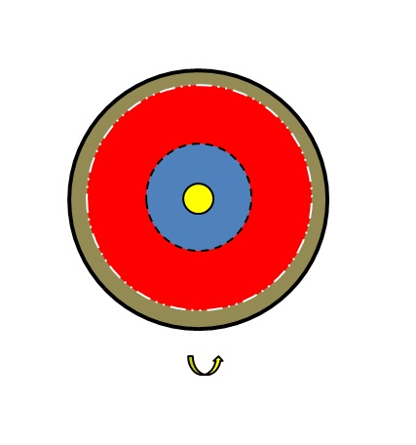
The heart of the earth after lucifer’s rebellion

Slide 15
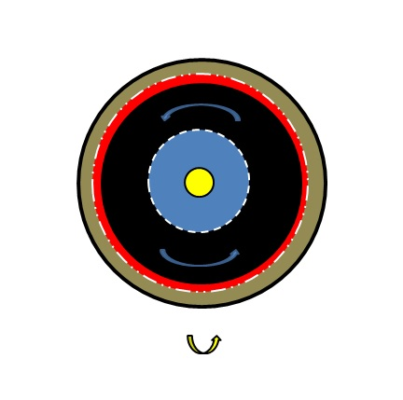
Renovation due to the spirit of god moving for old testament saints

Slide 16
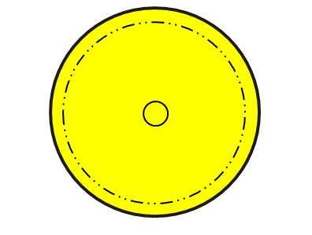
Adam in innocence

Slide 17
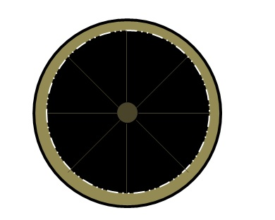
Adam after the fall

Slide 18
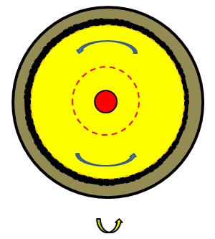
The new birth

Slide 19
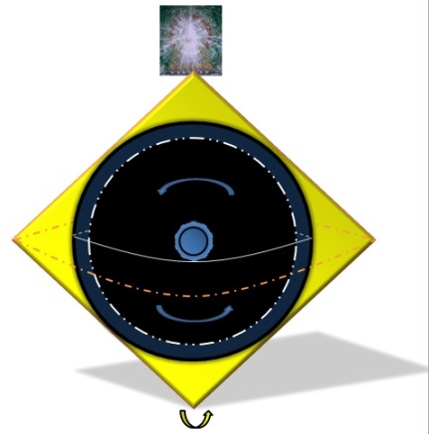
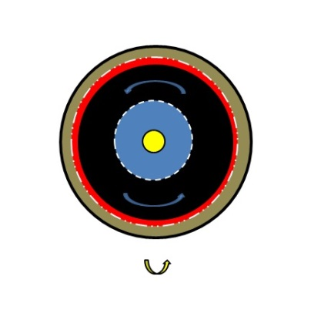
God’s mirrored work to get himself all in all
GOD

Slide 20
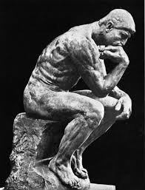
ANY QUESTIONS??!

Slide 21
CONE AND SPHERE OF RADIUS/BASE RADIUS R HAVE THE SAME VOLUME!

